Slide 1
Quality Club Meetings
Re-name Yourself in Zoom
(include your role)
Example: VPE Sandy Chen
For Technology Support
Chat with Zoom Master

Slide 2
Quality Club Meetings
Session #
Please “re-name” yourself to include your role
(Example: VPE Sandy Chen)
Receive Session workbook in chat

Slide 3
Agenda
Impact of Quality Meetings on a Club
What is a Quality Meeting?
Delivering Quality Meetings
Quality
Club Meetings

Slide 4


Identify
Identify
Develop
Identify what a quality club meeting is
Identify what goes into preparing quality club meetings
Develop strategies to consistently deliver quality club meetings

Slide 5

Impact of Quality Meetings on a Club
Notes:
http://newportcentertoastmasters.org/wp-content/uploads/2016/11/Newport-Center-Toastmasters-Meeting-on-November-21-2016-1080x675.jpg

Slide 6
How do quality meetings increase engagement?

Slide 7
How do quality meetings increase member retention?

Slide 8
How do quality meetings encourage members to volunteer for leadership roles?

Slide 9
How do quality meetings support member growth?

Slide 10
Review: Impact of Quality Meetings on a Club
Quality meetings improve member retention, encourage members to fill roles, and increase interest in club officer roles.

Slide 11
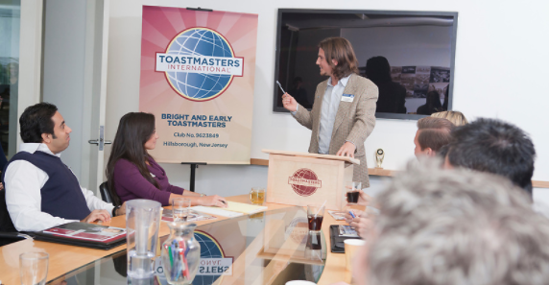
What is a Quality Meeting?
Notes:
https://miro.medium.com/max/10368/1*m0Nu9wbCQH3nWwSDwKXuzw.jpeg

Slide 12
Breakout Room Activity:
Defining Quality

Slide 13

Breakout Room Tips
Click “Join Breakout Room” button
Use Zoom tools as needed (Share Screen, Annotate, Whiteboard)
Assign a Timekeeper
Watch for Broadcast and Chat messages
Use “Ask For Help” button
Join Breakout Room

Slide 14
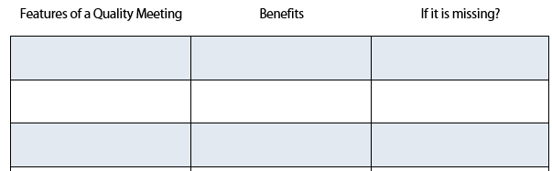
Defining Quality Activity Instructions
  Join your team in a breakout room (automatic)
  Use the table and guiding questions in your Session Workbook to identify the characteristics of a quality meeting

Slide 15
Defining Quality Activity Instructions
  Discuss how your club can tell if those characteristics are consistently present in club meetings
  You have 15 minutes
  Start on page 2 in your Session Workbook

Slide 16
Review: What is a Quality Meeting?
We can do a variety of things to make a meeting engaging, impactful, and fun.
Understanding what a quality meeting is the first step towards successful meetings.
Notes:
There is no one thing that can be done to make a meeting engaging, impactful, and fun. It takes a focused team of leaders, a membership with a shared vision, and a habit seeking and implementing feedback.

Slide 17

Delivering Quality Meetings

Slide 18

Categories
Of Quality
Fostering a Culture of Excellence
Meeting Member Needs
Conducting Smooth and Impactful Meetings
Member Engagement

Slide 19
Breakout Room Activity:
Formula for Success

Slide 20
Breakout Room Tips
Click “Join Breakout Room” button
Use Zoom tools as needed (Share Screen, Annotate, Whiteboard)
Assign a Timekeeper
Watch for Broadcast and Chat messages
Use “Ask For Help” button
Join Breakout Room

Slide 21
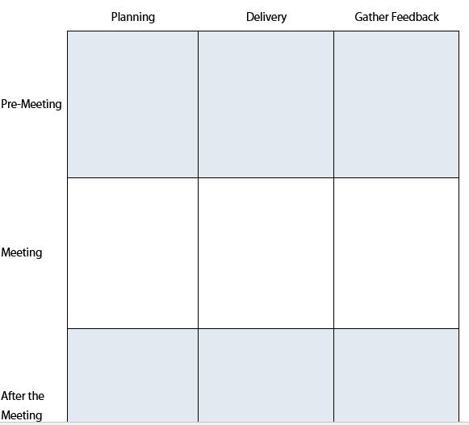
Formula for Success Activity Instructions
  Join your team in a breakout room (automatic)
  Choose one of the four Categories of Quality.
  Discuss how to plan, deliver and get feedback on your category. Record your results in the table provided.

Slide 22
Formula for Success Activity Instructions
  Select a spokesperson to present your group’s key ideas and takeaways for up to 2 minutes
  You have 20 minutes
  Start on page 3 in your Session Workbook

Slide 23
Present your results, key ideas, and recommendations
(up to 2 minutes per team)

Slide 24
Review: Delivering Quality Meetings
Quality meetings require dedicated and focused planning to deliver value to members.

Slide 25
Conclusion
Impact of Quality Meetings on a Club
What is a Quality Meeting?
Delivering Quality Meetings
Quality
Club Meetings

Slide 26
What is one thing you learned from this session that you will implement in your club?

Slide 27
Session Assessment
Go to link in Chat
You have 5 minutes

Slide 28
[Insert text]

