Slide 1
Prospective Member Engagement
Re-name Yourself in Zoom
(include your and role)
Example: VPE Sandy Chen
For Technology Support
Chat with Zoom Master

Slide 2
Prospective Member Engagement
Session #
Please “re-name” yourself to include your role
(Example: VPE Sandy Chen)
Receive participant workbook in chat

Slide 3
Agenda
Prospective
Member Engagement
Pre-work Debrief
Prospective Member Journey

Slide 4


Recognize
Identify
Identify
Recognize the phases of the Prospective Member Journey
Identify critical activities during the Prospective Member Journey
Identify resources for engaging during the Prospective Member Journey

Slide 5

Pre-work Debrief

Slide 6

Prospective Member Journey
Awareness
Evaluation
Join
Support

Slide 7
Put yourself in the shoes of a prospective member:
How do you decide what to spend your free time doing?

Slide 8

Awareness Phase
Prospective Members are:
Aware that they have a need or a problem
Actively researching how to address their need or solve their problem
Seeking a clear and understandable product offering

Slide 9
As a prospective customer:
How do brands enable you to try their products?

Slide 10

Evaluation Phase
Prospective Members:
Compare your products and services to other options
Want proof that you can deliver

Slide 11
Think about your experience as a prospective customer:
What was the most complicated purchase you have ever made?

Slide 12

Join Phase
Prospective Members:
How do they commit?
They need a straightforward process for joining that supports their decision to trust the product

Slide 13
As a customer, what have your favorite brands done to support you after you purchased their product?

Slide 14

Support Phase
How do members ask for help?
How do we check in to see how they are doing with their goals?
How do you know if they are satisfied?

Slide 15
Review: Pre-work Debrief
The four stages of the Prospective Member Journey give us a framework to discuss their experience and what we do to support them during their journey.

Slide 16

Prospective Member Journey

Slide 17
Breakout Room Activity:
New Member Experience Mapping

Slide 18

Breakout Room Tips
Click “Join Breakout Room” button
Use Zoom tools as needed (Share Screen, Annotate, Whiteboard)
Assign a Timekeeper
Watch for Broadcast and Chat messages
Use “Ask For Help” button
Join Breakout Room

Slide 19
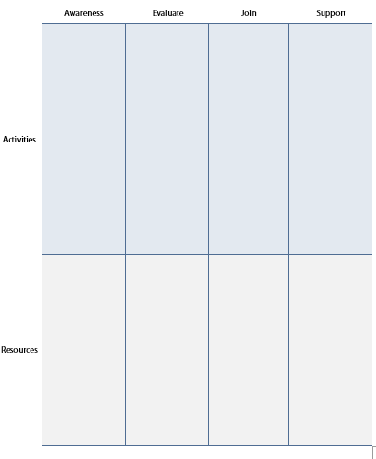
New Member Experience Activity Instructions
  Join your team in a breakout room (automatic)
  Using the table in your Participant Workbook, describe what a club should do (Activities) in each phase to support a prospective member.

Slide 20
New Member Experience Activity Instructions
  You will need to identify what a club would need (Resources) in each phase to implement what they should be doing.
  Be prepared to pitch your ideas to the group for at least 2-3 minutes
  You have 20 minutes
  Start on page 2 in your Participant Workbook

Slide 21
Present your results, key ideas, and recommendations for each phase
(2-3 minutes per team)

Slide 22
Review: New Member Experience Mapping
Deliver value at every stage of the Prospective Member Journey

Slide 23
Conclusion
Prospective Member Engagement
Pre-work Debrief
Prospective Member Journey

Slide 24
What is one thing you learned from this session that you will implement in your club?

Slide 25
Session Assessment
Go to link in Chat
You have 5 minutes

Slide 26
[Insert text]

