Slide 1
Marketing
Re-name Yourself in Zoom
(include your role)
Example: VPE Sandy Chen
For Technology Support
Chat with Zoom Master

Slide 2
Marketing
Session #
Please “re-name” yourself to include your role
(Example: VPE Sandy Chen)
Receive participant workbook in chat

Slide 3
What is marketing?

Slide 4
Agenda
Effective Messaging
“Speaking” to Prospective Members
Tools and Resources
Marketing

Slide 5





Align
Develop
Identify
Align marketing with prospective member goals
Develop strategies for compelling communication with prospective members
Identify resources available for club marketing

Slide 6

Effective Messaging

Slide 7
Breakout Room Activity:
Crafting the Message

Slide 8

Breakout Room Tips
Click “Join Breakout Room” button
Use Zoom tools as needed (Share Screen, Annotate, Whiteboard)
Assign a Timekeeper
Watch for Broadcast and Chat messages
Use “Ask For Help” button
Join Breakout Room

Slide 9
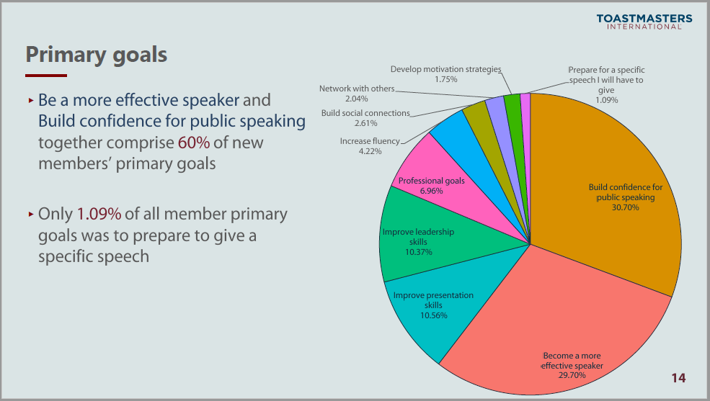
Crafting the Message Activity Instructions
  Join your team in a breakout room (automatic).
  Select a goal that your group believes represents a popular goal for members of your club.

Slide 10
Crafting the Message Activity Instructions
  Join your team in a breakout room (automatic).
  Make a list of steps a member must follow to achieve that goal.
  Then identify how your club supports a member in achieving that goal and use the questions to guide your discussion.
  You have 25 minutes
  Start on page 2 in your Participant Workbook

Slide 11
Share the message your group crafted.

Slide 12
Review: Crafting the Message
Connect with people’s goals.
Great marketing communicates the value your club delivers to prospective members.

Slide 13

“Speaking” to Prospective Members

Slide 14
Breakout Room Activity:
Sending the Message

Slide 15
Member Personas
The Student
The Early Career Enthusiast
The Striving Associate
The Social Professional
The Confident Leader
The Successful Leader
The Retiree

Slide 16
Breakout Room Tips
Click “Join Breakout Room” button
Use Zoom tools as needed (Share Screen, Annotate, Whiteboard)
Assign a Timekeeper
Watch for Broadcast and Chat messages
Use “Ask For Help” button
Join Breakout Room

Slide 17
Sending the Message Activity Instructions
  Join your team in a breakout room (automatic).
  Select a member persona from 2020 Member Persona. Report that best represents your club’s opportunity for growth.
  Use the goal you selected in the previous breakout room activity.

Slide 18
Sending the Message Activity Instructions
  Use the questions in your Participant Workbook to guide your discussion on how to communicate your club’s value to prospective members.
  Select a spokesperson to present your group’s key ideas and takeaways for up to 2 minutes.
  You have 20 minutes.
  Start on page 5 in your Participant Workbook

Slide 19
Present your results, key ideas, and recommendations
(up to 2 minutes per team)

Slide 20
Review: Sending the Message
Identify who would be most interested in the goals that your club supports.
Select the best method to communicate why someone should join your club.

Slide 21

Tools and Resources

Slide 22
What tools and resources have you used or seen used that were effective?

Slide 23
Review: Tools and Resources
In addition to the tools and resources shared here, there is a list of both on page 8 in your Participant Workbook.

Slide 24
Conclusion
Effective Messaging
“Speaking” to Prospective Members
Tools and Resources
Marketing

Slide 25
What is one thing you learned from this session that you will implement in your club?

Slide 26
Session Assessment
Go to link in Chat
You have 5 minutes

Slide 27
[Insert text]

