Slide 1
Club Success Plan
Re-name Yourself in Zoom
(include your role)
Example: VPE Sandy Chen
For Technology Support
Chat with Zoom Master

Slide 2
Club Success Plan
Session #
Please “re-name” yourself to include your role
(Example: VPE Sandy Chen)
Receive Session Workbook in chat

Slide 3
Agenda
Club
Success Plan
Improving Plans
Club Success Plan Simulation

Slide 4

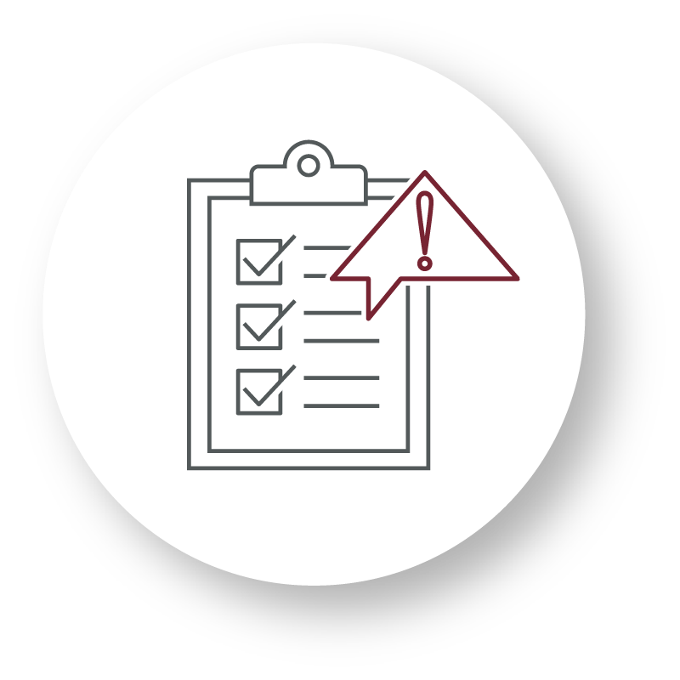
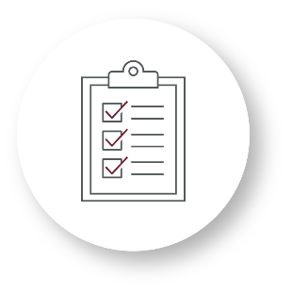

Recognize
Assess
Develop
Recognize the advantages to good planning
Assess and revise planning documents to improve effectiveness
Develop planning documents to effectively target goals

Slide 5

Improving Plans

Slide 6
What brings people to Toastmasters?
What are their goals?

Slide 7
Breakout Room Activity:
Making the Plan Right

Slide 8

Breakout Room Tips
Click “Join Breakout Room” button
Use Zoom tools as needed (Share Screen, Annotate, Whiteboard)
Assign a Timekeeper
Watch for Broadcast and Chat messages
Use “Ask For Help” button
Join Breakout Room

Slide 9
Making the Plan Right Activity Instructions
  Join your team in a breakout room (automatic)
  Read each of the three scenarios and Club Success Plans in your participant workbook. Edit plans provided.
  You have 20 minutes
  Start on page 2 in your Session Workbook

Slide 10
What were the most common issues with the Club Success Plans that you edited?

Slide 11
What are the risks of not refining the plan?

Slide 12
Review: Improving Plans
Get feedback from your Area Director
Review, reconsider, and revise your Club Success Plan periodically

Slide 13

Club Success Plan Simulation

Slide 14
Breakout Room Activity:
Club Success Plan Simulation

Slide 15
Breakout Room Tips
Click “Join Breakout Room” button
Use Zoom tools as needed (Share Screen, Annotate, Whiteboard)
Assign a Timekeeper
Watch for Broadcast and Chat messages
Use “Ask For Help” button
Join Breakout Room

Slide 16
CSP Simulation Activity Instructions
  Join your team in a breakout room (automatic)
  Read the two simulations and Dashboard information for a club. Discuss and fill out the sections of the Club Success Plan provided.
  You have 20 minutes
  Start on page 9 in your Session Workbook

Slide 17
Simulation 1 Results

Slide 18
Simulation 2 Results

Slide 19
Review: Club Success Plan Simulation
Share and agree on your planning process and best practices before you begin to plan.

Slide 20
Conclusion
Club Success Plan
Improving Plans
Club Success Plan Simulation

Slide 21
What is one thing you learned from this session that you will implement in your club?

Slide 22
Session Assessment
Go to link in Chat
You have 5 minutes

Slide 23
[Insert text]

